Slide 1
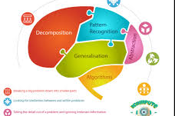
Records
Year 12

Slide 2

Objectives
Students will
demonstrate an understanding of the purpose of a record structure
write pseudocode to define, read data from, and save data to a record structure.

Slide 3

DATA TYPE
There are different data structure that is used by the computer to store data
These are divided in two types
Primitive
Non-primitive

Slide 4
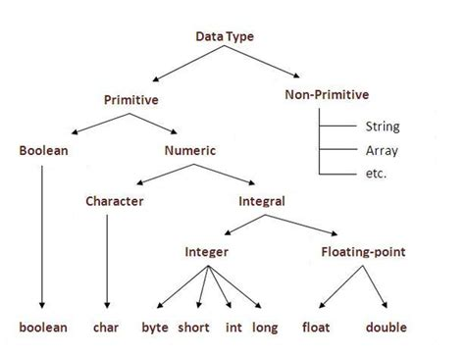
DATA TYPE

Slide 5
Primitive Data Structure
Primitive Data Structure is also called Built-in Data structures because they are built into a programming language
They are atomic and cannot be divided further
They are the basic data types that are available in most of the programming languages.
Examples of primitive data structure
Integer, Float, Boolean, Char etc

Slide 6
Non-Primitive Data Structures
Also known as Composite or User Defined Data Structure
They are complex Structures, that are used to store large groups of connected data.
They are not atomic and cannot be formed without using primitive data structure.
These are created by combining primitive data types or other non-primitive data types.
Examples include arrays, records (structs), classes, and objects.
They allow for more complex structures and are defined by the user or provided by the programming language.

Slide 7
Question???????
Imagine you are designing a database for a cutting-edge research project that involves analyzing data from multiple sources, each with different data types and structures.
How would you organize and manage this diverse set of information efficiently and coherently in a computer system?"

Slide 8
Question????????
"Consider the complexities involved – data ranging from text to numerical values, images, and more.
How can we ensure that this vast and diverse dataset is not only stored but can be easily accessed and manipulated for meaningful insights?

Slide 9

Records
A record structure is like a container that holds different pieces of information about a single entity.“
A record structure helps us organize all pieces of information together.“
e.g. Think about a student in a school. What information would you need to store about them? Their name, age, grade, and maybe even their favorite subject

Slide 10
Records-importance
Records play a vital role in enhancing data
Organization-using one identifier facilitates efficient data management
Integrity- group related data helps to maintain integrity
Access – efficiency of retrieval and manipulation in programs
code readability –enhance code readability makes it easier for programmers to understand and maintain complex system.

Slide 11
Records- Type
The record type is known as a user-defined type, because the programmer can decide which variables (fields) to include as a record.
Think of a data base with table that contains different field with different data types and the record that represents information about one instance of that entity

Slide 12

Record structure

Slide 13
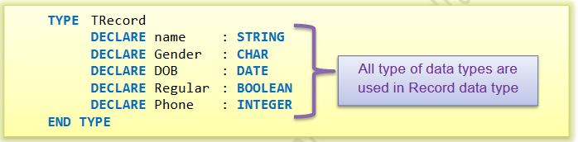
Record declaration
TYPE <TypeIdentifier>
DECLARE <field identifier> : <data type>
ENDTYPE.

Slide 14

Record declaration
A variable can then be declared as follows:
"Declare a variable named newstudent of type TRecord
TRecord is a previously defined record type."
This variable can now store and manage data in a structured way, with fields defined by the TRecord type.

Slide 15
Record declaration
Adding information the:
"TYPE TRecord
DECLARE name : STRING
DECLARE gender : CHAR
DECLARE DOB : DATE
DECLARE GPA : REAL
ENDTYPE.
DECLARE newstudent : TRecord
// Input or assign values to the fields of newstudent
nestudent.name ← "John Doe"
newstudent.age ← 18
newstudent.studentID ← "S123456"
newstudent.GPA ← 3.8
.

Slide 16

Record declaration
Individual data item can then be accessed using a dot notation:

Slide 17
Creating Records: Python
In Python, you can create records using classes. Each attribute in the class represents a field in the record.
class Person:
def __init__(self, name, age, address):
self.name = name
self.age = age
self.address = address
Above a Person record with three fields: name, age, and address.
To create an instance of this record:
# Creating a Person record instance
person1 = Person("Alice", 30, "123 Main St.")

Slide 18
Once a record type is defined, you can declare and initialize instances of that record. Its importance to initialize all the fields to meaningful values. # Creating instances of the Person record person1 = Person("Alice", 30, "123 Main St.") person2 = Person("Bob", 25, "456 Elm St.")
Creating Records: Python

Slide 19
Accessing Fields in a Record: Python
Once a record type is defined, you can declare and initialize instances of that record.
Accessing fields in a record is done my using the instances of the record followed by the .field
# Accessing fields in the Person record
print(person1.name) # Output: "Alice"
print(person2.age) # Output: 25

Slide 20
Modifying Record: Python
Modifying a record is done by assigning a new value to their fields
# Modifying a field in the Person record
person1.age = 31
print(person1.age) # Output: 31

Slide 21
Records using functions: Python
def calculate_average_age(person1, person2):
average_age = (person1.age + person2.age) / 2
return Person("Average Person", average_age, "")
average_person = calculate_average_age(person1, person2)
print(average_person.name, average_person.age) # Output: "Average Person" 27.5

Slide 22


Thank you
@Jenny.com

